Slide 1
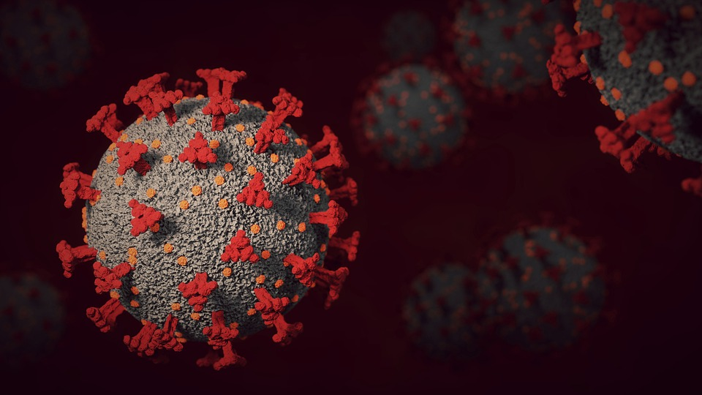
Covid-19 Presence Prediction
Covid-19 Presence Prediction
Case study done by
Sharon Sam Simpson

Slide 2
Machine learning-based prediction of COVID-19 diagnosis based on symptoms

Slide 3
Agenda
Introduction
- Covid-19
- Diagnose Tests(RT-PCR)
- Symptoms of Covid-19
Problem Statement
Proposed System
Dataset Description
Preprocessing Techniques
Model Building
Error Metrics
Real-time usage
Conclusion

Slide 4
Introduction – Covid-19
COVID-19 is the infectious disease caused by the most recently discovered coronavirus
“CO” stands for corona;
“VI” for virus;
“19” the year in which it appeared.
This new virus and disease were unknown before the outbreak began in Wuhan, China, in December 2019.
Coronaviruses are known to cause respiratory infections ranging from the common cold to more severe diseases.
The novel coronavirus disease 2019 (COVID-19) pandemic caused by the SARS-CoV-2
It poses a critical and urgent threat to global health and mitigate the burden on healthcare systems.

Slide 5
Diagnose Tests (RT-PCR)
RT-PCR is real-time reverse transcription–polymerase chain reaction assay
Effective screening of SARS-CoV-2 enables efficient diagnosis of COVID-19
Developed to rapidly detect the severe acute respiratory syndrome–associated coronavirus which will aid in diagnosing SARS-Cov infection.
Materials and Methods
Clinical Specimens - nasopharyngeal swab
Virus Culture
Nucleic Acid Extraction
Primers and Probes

Slide 6
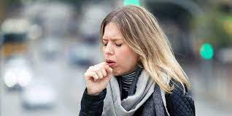
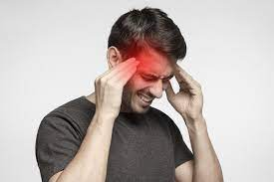

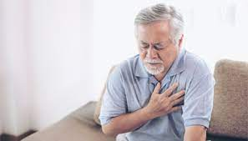

Symptoms of Covid-19
Headache
Cough
Sore throat
Fever
Shortness of breath

Slide 7
Problem Statement - E³
Enable quick and efficient diagnosis of COVID-19
Establish a machine-learning approach to predict the presence of coronavirus.
Ensure to assist medical staff worldwide, especially in the context of limited healthcare resources.
The Intent of the project is to create a user interface application based on Machine Learning Models for prediction of Covid-19 presence that aims to assist medical staff worldwide by implementing the proposed system.

Slide 8





Proposed System
Dataset collection
Pre-processing
Model Building
Model Evaluation
App Creation

Slide 9
Data Description
Produced by the Israeli Ministry of Health.
Data of individuals who were tested for SARS-CoV-2 via RT-PCR assay of a nasopharyngeal swab.
The dataset contains initial records, on a daily basis, of all the residents who were tested for COVID-19 nationwide.
Total no. of samples = 91,47,169
Total no. of features = 10
Total no. of elements = 9,14,71,690

Slide 10
Dataset - Features
Dataset contains 8 binary input features and 1 output feature.
Basic information:
1.Sex (male/female).
2.Age ≥60 years (true/false)
Symptoms:
3.Cough (true/false).
4.Fever (true/false).
5.Sore throat (true/false).
6.Shortness of breath (true/false).
7.Headache (true/false).
Other information:
8.Known contact with an individual
confirmed to have COVID-19
(true/false).
Target variable:
9. corona result (true/false).

Slide 11
Pre-processing
Load Full Data
Deletion of unwanted features
Dealing with missing data
Translation - Hebrew words to English
Converting Categorical Variables into numeric
Format Feature Names if needed
Sampling the dataset into compactible size

Slide 12
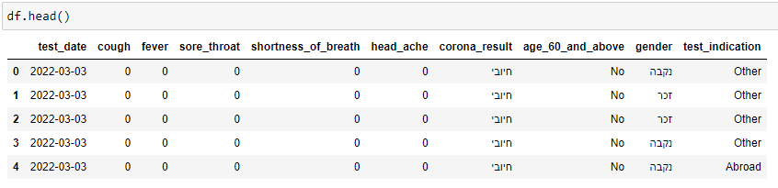
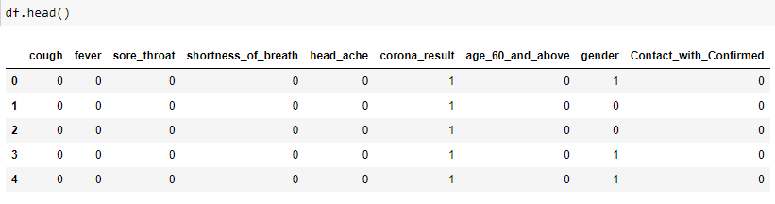
Comparison – Glimpse of Data
Before Preprocessing
After Preprocessing

Slide 13
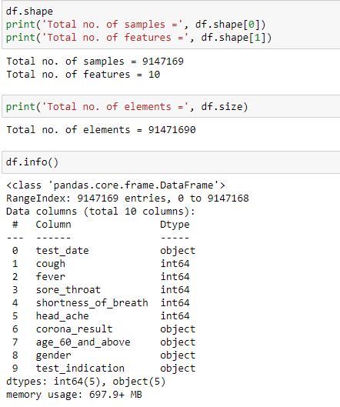
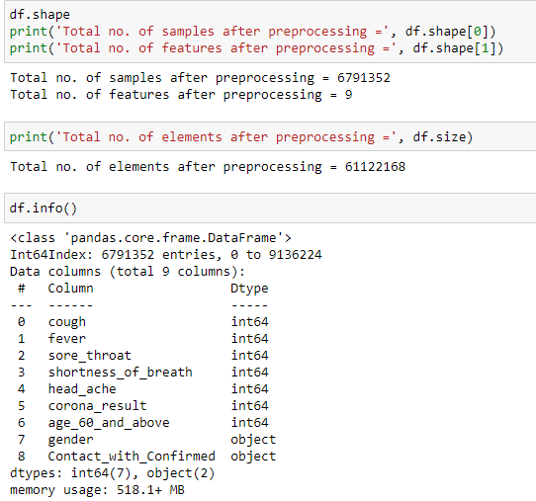
Comparison – About Dataset
Before Preprocessing
After Preprocessing

Slide 14
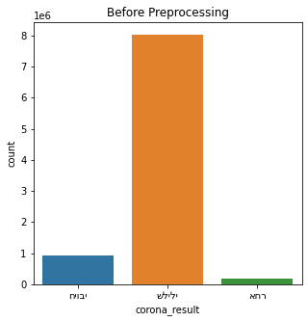
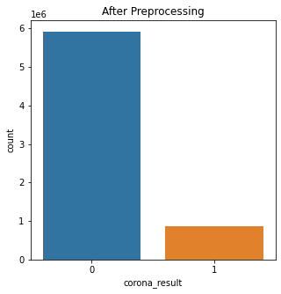
Comparison – Viz of Target Variable

Slide 15
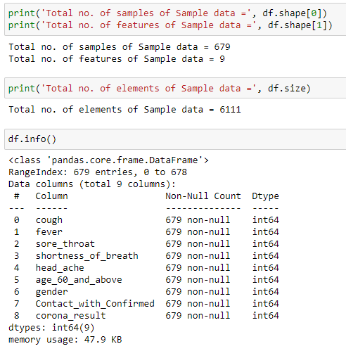
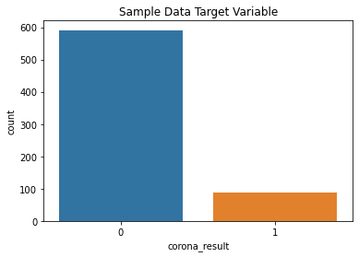
Data Preparation for Model Building - Sampling the data
Sample Data
The data is moderately biased and imbalanced

Slide 16
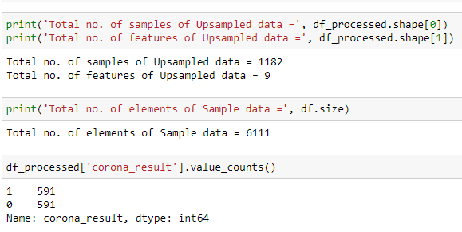
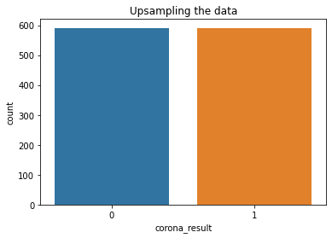
Data Preparation for Model Building - Upsampling the data
Upsampling the Data
Now the data is Balanced

Slide 17
Model Building
Used a set of Supervised Machine Learning Classification Models for Model Selection
Train size = 75%
Test size = 25%
Models:
Logistic Regression
Random Forest Classifier
K Nearest Neighbors Classifier
Decision Tree Classifier

Slide 18
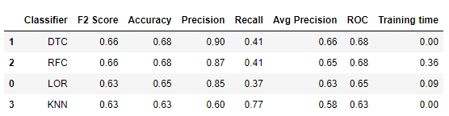
Model Evaluation

Slide 19
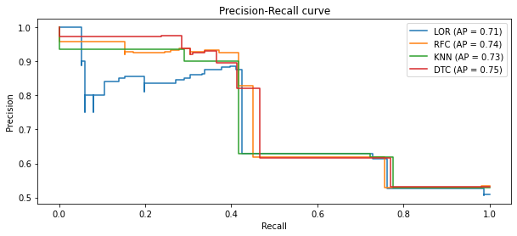
Model Evaluation

Slide 20
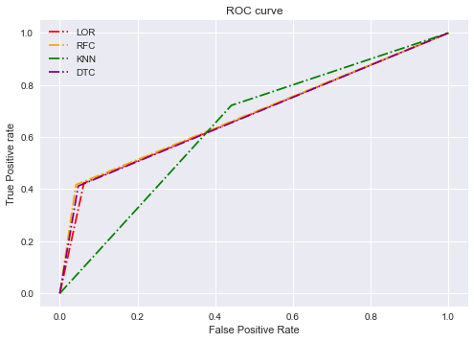
Model Evaluation

Slide 21
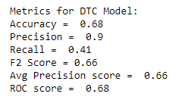
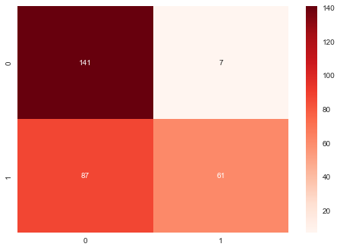
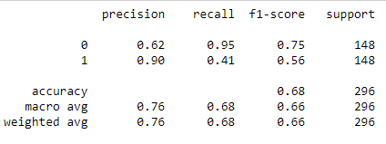
Model Decision Tree Classifier
Confusion Matrix
Classification Report

Slide 22
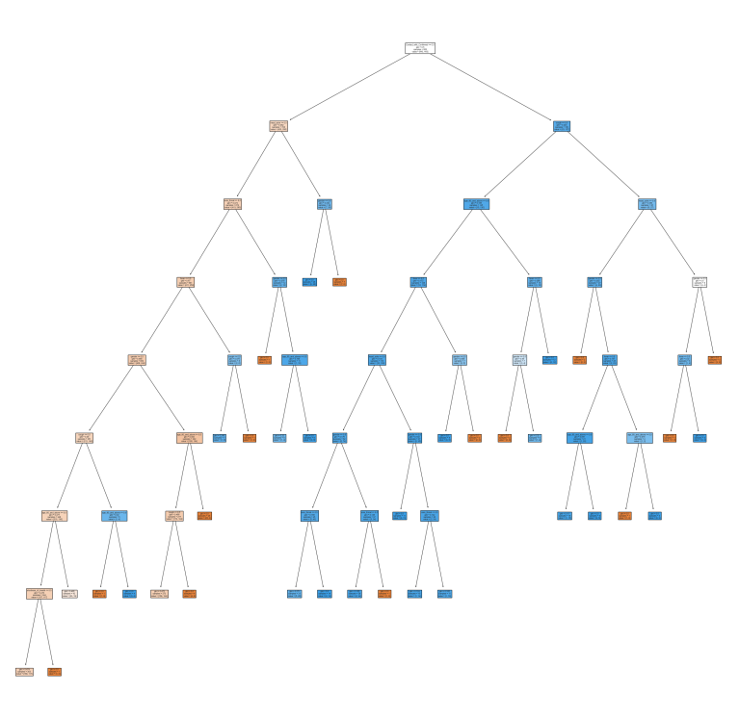
Model – Decision Tree Classifier - Tree Viz

Slide 23
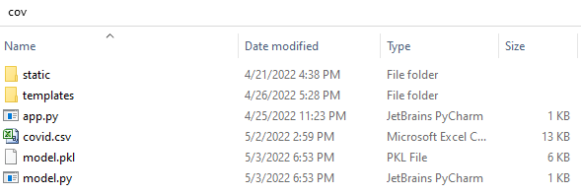
App Creation - Flask

Slide 24
Flask App Demo

Slide 25
Conclusion
Conclusion & Confrontations:
Dataset Collection from a legal source is a big task.
Training time for Model building for a large dataset is for hours.
Increasing the accuracy of the model is vital and challenging task.
The scope of understanding the case study for COVID-19 PREDICTION using ML have been grasped and developed the knowledge by various steps such as data collection, data preprocessing, model building and evaluation and finally creating a real-time user application.
References:
https://www.nature.com/articles/s41746-020-00372-6

Slide 26
Stay Safe !!!

